Slide 1
Cloud Computing on AWS

Slide 2
Introduction to Terraform
What is Terraform?
Terraform is an open-source Infrastructure as Code (IaC) tool developed by HashiCorp. It allows you to define, provision, and manage infrastructure using a declarative configuration language. Terraform helps automate infrastructure deployment and ensures consistency across environments.
Why Use Terraform?
Infrastructure as Code (IaC) – Write infrastructure configurations in code format for consistency and automation.
Multi-Cloud Support – Works with AWS, Azure, Google Cloud, and many other providers.
Declarative Approach – Define what you want (desired state), and Terraform figures out how to achieve it.
Automation & Efficiency – Automates resource provisioning, scaling, and management.
State Management – Tracks the current infrastructure state and updates only what has changed.
Modularity & Reusability – Use modules to simplify complex deployments.

Slide 3
How Terraform Works
Terraform follows a simple workflow:
Write – Define infrastructure in Terraform configuration files (.tf files).
Plan – Run terraform plan to preview the changes Terraform will make.
Apply – Run terraform apply to create or update infrastructure.
Destroy – Use terraform destroy to remove resources when no longer needed.
Basic Terraform Components
Providers – Plugins that interact with cloud platforms (e.g., AWS, Azure, GCP).
Resources – Infrastructure components like EC2 instances, VPCs, databases, etc.
Variables – Allow parameterization for reusable configurations.
State Files – Keep track of the deployed infrastructure.
Modules – Group resources together for reuse and better organization.

Slide 4
Introduction to AWS VPC (Virtual Private Cloud)
Amazon Web Services (AWS) Virtual Private Cloud (VPC) is a service that allows you to create a logically isolated network within the AWS cloud, where you can launch and manage AWS resources in a secure and controlled environment. It provides a private network within the AWS infrastructure, giving you full control over your virtual networking environment, including aspects like IP address range, subnets, route tables, and network gateways.
AWS VPC is essential for users who want to have secure, isolated environments within the cloud to run applications or host services, while maintaining control over networking aspects such as security, traffic routing, and connectivity to on-premises data centers.
Key Features of AWS VPC:
Subnets:
VPCs are divided into subnets, which allow you to organize resources based on their function or security requirements.Subnets can be public (accessible from the internet) or private (isolated from the internet), and you can set up separate subnets for different tiers, such as application, database, and web layers.
Route Tables:
Route tables define how traffic is directed between subnets within the VPC or between the VPC and external networks (like the internet or on-premises networks).
You can customize routing to control traffic flow, like directing traffic from a public subnet to the internet or allowing private subnets to communicate with resources in other subnets.

Slide 5
Internet Gateway (IGW):
An Internet Gateway allows instances within a public subnet to connect to the internet, enabling external access for services or applications hosted on AWS.It facilitates bidirectional communication between your VPC and the internet.
NAT Gateway and NAT Instances:
For private subnets that need to access the internet (for example, for software updates), a Network Address Translation (NAT) Gateway or NAT Instance can be set up in a public subnet.These allow resources in private subnets to send traffic to the internet without exposing them directly.
Components of AWS VPC:
VPC: The overall isolated network environment.
Subnets: Divisions within the VPC that segregate resources for organizational and security purposes.
Internet Gateway (IGW): A gateway to enable internet access for resources in public subnets.
NAT Gateway/Instance: Allows internet access from private subnets.
Route Tables: Determine how traffic flows between subnets, VPCs, and external networks.
Security Groups and NACLs: Provide security for network traffic to and from resources.
Peering Connections: Allow VPCs to communicate with each other.

Slide 6
Introduction to AWS Security Groups
In Amazon Web Services (AWS), Security Groups are virtual firewalls that control inbound and outbound traffic to AWS resources such as EC2 instances, databases, and other services. They play a critical role in securing cloud resources by defining what network traffic is allowed or denied to reach those resources.
Security Groups operate at the instance level and are associated with network interfaces of resources (such as EC2 instances) within a Virtual Private Cloud (VPC). They are used to control access based on IP address, port, and protocol type, allowing you to protect your resources from unauthorized access.
Key Features of AWS Security Groups:
Stateful:
Security Groups are stateful, meaning if you allow an incoming request, the response is automatically allowed, regardless of outbound rules. For example, if you allow an inbound connection on port 80 (HTTP), the return traffic is automatically allowed without needing to define a specific outbound rule for it.
Inbound and Outbound Rules:
You can define both inbound (incoming) and outbound (outgoing) traffic rules.
Inbound rules specify what traffic is allowed to reach your resources (e.g., HTTP requests to a web server).
Outbound rules define the traffic that can leave your resources (e.g., responses to the client’s request or communication with another server).

Slide 7
Introduction to AWS EC2 (Elastic Compute Cloud)
Amazon Elastic Compute Cloud (EC2) is a core component of Amazon Web Services (AWS), providing scalable, on-demand compute capacity in the cloud. EC2 allows users to run virtual machines (known as instances) on AWS infrastructure, enabling them to quickly scale applications and manage workloads without having to invest in physical hardware.
AWS EC2 offers flexibility and control over computing resources, allowing you to choose the configuration, operating system, and networking options based on your specific needs. It is widely used for hosting websites, running applications, processing large datasets, and building cloud-based infrastructures.
Key Features of AWS EC2:
Scalability:
EC2 instances can be launched or terminated at any time, allowing you to scale your compute capacity based on demand. You can scale vertically (by upgrading instance types) or horizontally (by adding more instances).
Flexible Instance Types:
EC2 offers a wide variety of instance types optimized for different use cases, such as compute-optimized, memory-optimized, storage-optimized, and GPU instances. Some common instance families include:
General Purpose: Balanced compute, memory, and networking resources (e.g., T3, M5).
Compute Optimized: For compute-intensive workloads (e.g., C5).
Memory Optimized: For memory-intensive applications (e.g., R5).
Storage Optimized: For workloads requiring high disk throughput (e.g., I3).
Accelerated Computing: For applications requiring GPU support (e.g., P4, G4 instances).

Slide 8
Common Use Cases for AWS EC2:
Web Hosting and Application Servers:
EC2 is often used to host websites and web applications. With its scalability, it can handle varying traffic loads by scaling up or down based on demand.
Running Databases:
EC2 can be used to run databases such as MySQL, PostgreSQL, and MongoDB. Combined with Amazon RDS, it allows users to run and scale relational databases without the management overhead.
Big Data and Analytics:
EC2 is suitable for processing large datasets, running data analytics tools like Apache Hadoop or Apache Spark, and providing computational power for data-intensive applications.
DevOps and Continuous Integration/Continuous Deployment (CI/CD):
EC2 instances are commonly used in DevOps pipelines to run test environments, build systems, and staging servers to support automated development workflows.
Machine Learning and AI:
EC2 provides GPU instances (e.g., P3, G4) for machine learning, AI model training, and other computationally intensive tasks like image or video processing.

Slide 9
What is AWS IAM?
AWS Identity and Access Management (IAM) is a global AWS service that allows you to securely manage access to AWS services and resources. It ensures that only authorized users or applications can perform specific actions on AWS resources.
IAM is a free service that comes with every AWS account.
IAM Core Components
(a) IAM Users
Represents an individual (person or application).
Each user has unique credentials (username/password, access keys).
Can be assigned permissions via policies.
Can be part of groups to inherit permissions.
Example: A developer needing access to EC2 instances.
(b) IAM Groups
A collection of IAM users with shared permissions.
Makes permission management easier.
Users inherit the permissions of the group.
Example: A "Developers" group with access to EC2 and S3.

Slide 10
(c) IAM Roles
Temporary access credentials (no passwords or long-term access keys).
Used by AWS services, users, or external accounts.
Follows the assume role mechanism.
Example: An EC2 instance assuming a role to access an S3 bucket without needing access keys.
(d) IAM Policies
JSON-based documents that define permissions.
Determines who can do what on which AWS resources.
Two types:Managed Policies (AWS provides predefined policies like AdministratorAccess, AmazonS3ReadOnlyAccess).
Inline Policies (Custom policies directly attached to a user, group, or role).
(e) IAM Authentication & Security
Access Keys: Used for programmatic access (AWS CLI, SDKs).
MFA (Multi-Factor Authentication): Adds an extra security layer.

Slide 11

Project overview
Project Summary: AWS Infrastructure Setup with Terraform
This project provisions a scalable AWS infrastructure using Terraform, setting up a Virtual Private Cloud (VPC) with both public and private subnets, networking components like Internet Gateway (IGW) and NAT Gateway, security groups for EC2 and Jenkins, and IAM configurations. The infrastructure supports an EC2 instance for Jenkins and is designed for secure access and controlled networking.

Slide 12
Terraform configuration set up with Vpcs,Subnets,Route Tables,Internet gateway,Security groups,Ec2,IAM USER Groups.
Step 1 :
1.create a folder connect with visual studio code.
2. In a folder we can create a main.tf file.
3.In the visual studio code
The provided Terraform code creates a complete infrastructure on AWS that includes a VPC, EC2 instance, iam user groups. Here's a detailed step-by-step explanation of what each section of the code does:

Slide 13
Project Components and Details
1. AWS Provider Configuration
provider "aws" {
region = "us-east-1"
}
Defines AWS as the cloud provider.
Specifies the AWS region as us-east-1.

Slide 14
2. Networking Setup
VPC Creation
resource "aws_vpc" "main" {
cidr_block = var.vpc_cidr
enable_dns_support = true
enable_dns_hostnames = true
tags = {
Name = "MainVPC"
}
}
Creates a VPC (10.0.0.0/16) with DNS support enabled.

Slide 15
Subnet Configuration
variable "public_subnet_cidrs" {
default = ["10.0.1.0/24", "10.0.2.0/24", "10.0.3.0/24"]
}
variable "private_subnet_cidrs" {
default = ["10.0.4.0/24", "10.0.5.0/24"]
}
3 Public Subnets (10.0.1.0/24, 10.0.2.0/24, 10.0.3.0/24).
2 Private Subnets (10.0.4.0/24, 10.0.5.0/24).

Slide 16
Subnet Deployment
resource "aws_subnet" "public_subnets" {
count = length(var.public_subnet_cidrs)
vpc_id = aws_vpc.main.id
cidr_block = var.public_subnet_cidrs[count.index]
map_public_ip_on_launch = true
availability_zone = element(["us-east-1a", "us-east-1b", "us-east-1c"], count.index)
tags = {
Name = "PublicSubnet-${count.index + 1}"
}
}
Assigns public IP addresses to instances in these subnets.
Distributes subnets across availability zones for high availability.

Slide 17
resource "aws_subnet" "private_subnets" {
count = length(var.private_subnet_cidrs)
vpc_id = aws_vpc.main.id
cidr_block = var.private_subnet_cidrs[count.index]
availability_zone = element(["us-east-1a", "us-east-1b"], count.index)
tags = {
Name = "PrivateSubnet-${count.index + 1}"
}
}
Deploys private subnets for internal services.

Slide 18
3. Internet & NAT Gateway Configuration
Internet Gateway (for Public Subnets)
resource "aws_internet_gateway" "gw" {
vpc_id = aws_vpc.main.id
tags = {
Name = "InternetGateway"
}
}
Allows instances in public subnets to connect to the internet.

Slide 19
NAT Gateway (for Private Subnets)
resource "aws_eip" "nat" {
domain = "vpc"
}
resource "aws_nat_gateway" "nat" {
allocation_id = aws_eip.nat.id
subnet_id = aws_subnet.public_subnets[0].id # Deploys NAT in one public subnet
tags = {
Name = "NatGateway"
}
}
Allows outbound internet access for private subnet instances

Slide 20
4. Routing Tables
Public Route Table
resource "aws_route_table" "public_rt" {
vpc_id = aws_vpc.main.id
route {
cidr_block = "0.0.0.0/0"
gateway_id = aws_internet_gateway.gw.id
}
tags = {
Name = "PublicRouteTable"
}
}
Routes traffic from public subnets to the internet.

Slide 21
Private Route Table
resource "aws_route_table" "private_rt" {
vpc_id = aws_vpc.main.id
route {
cidr_block = "0.0.0.0/0"
nat_gateway_id = aws_nat_gateway.nat.id
}
tags = {
Name = "PrivateRouteTable"
}
}
Routes private subnet traffic through the NAT Gateway.

Slide 22
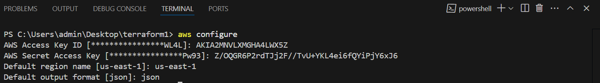
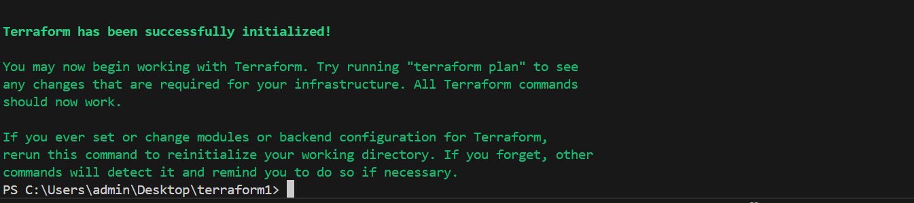
In aws console create access key in iam security credentials.
After run below commands in visual studio code
Step 2: aws configure
Step 3 : terraform init
The terraform init command initializes a working directory for use with Terraform

Slide 23
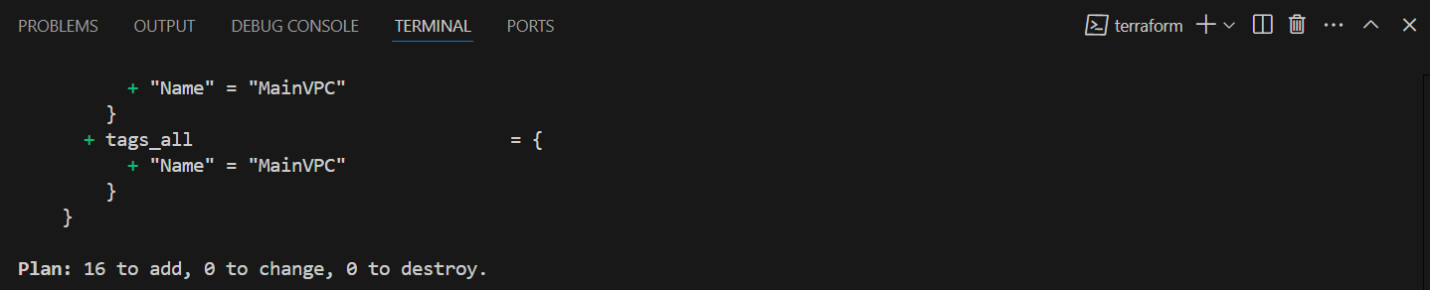
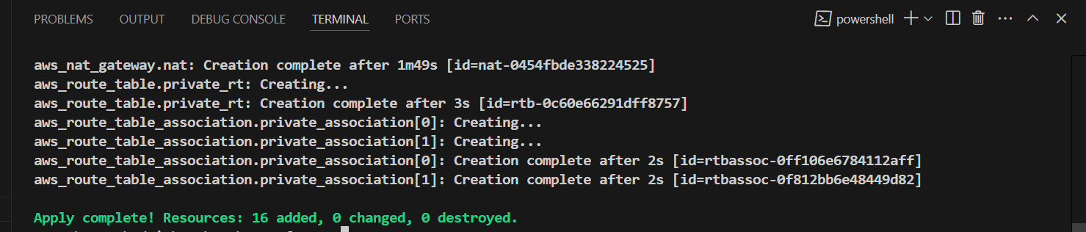
After vpc run this commands in visual studio code:
Terraform plan: The terraform plan command in Terraform previews the changes that Terraform will make to your infrastructure before you apply them.
After Terraform plan changes has been applied its shown below:
After next terraform apply (or) terraform apply –auto-approve use this commands
Terraform apply: In Terraform, the command terraform apply is used to apply the changes defined in the configuration files to the infrastructure. It initiates the process of provisioning or modifying resources in your environment based on the configurations you have written in .tf files.
After terraform apply changes has been applied its shown below:

Slide 24
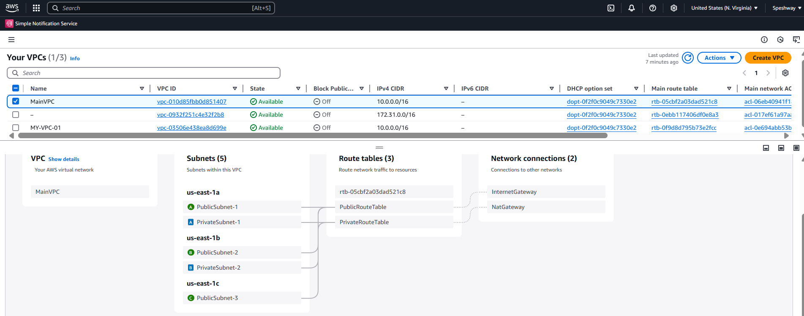
After apply vpcs, subnets(two private & three public),Route tables, internet gateways its shown below:

Slide 25
5.EC2 Security Group
resource "aws_security_group" "ec2_sg" {
vpc_id = aws_vpc.main.id
ingress {
from_port = 22
to_port = 22
protocol = "tcp"
cidr_blocks = ["0.0.0.0/0"]
}
ingress {
from_port = 6443
to_port = 6443
protocol = "tcp"
cidr_blocks = ["0.0.0.0/0"] # Kubernetes API Server
}

Slide 26
ingress {
from_port = 10250
to_port = 10255
protocol = "tcp"
cidr_blocks = ["0.0.0.0/0"] # Kubernetes Worker Nodes
}
ingress {
from_port = 30000
to_port = 32767
protocol = "tcp"
cidr_blocks = ["0.0.0.0/0"] # Kubernetes Services
}

Slide 27
ingress {
from_port = 2375
to_port = 2376
protocol = "tcp"
cidr_blocks = ["0.0.0.0/0"] # Docker API
}
ingress {
from_port = 8080
to_port = 8080
protocol = "tcp"
cidr_blocks = ["0.0.0.0/0"] # Jenkins Web UI
}

Slide 28
egress {
from_port = 0
to_port = 0
protocol = "-1"
cidr_blocks = ["0.0.0.0/0"]
}
tags = {
Name = "EC2SecurityGroup"
}
}
Allows access to Jenkins on port 8080.
Allows access to kubernetes on port 6443 .
Allows access to docker on port 2375.
Allows SSH access (port 22) from anywhere.

Slide 29
Create Key Pair
Before create key pair run the below command in empty gitbash.
(run this command in gitbash it will create keypair (ssh-keygen -t rsa -b 4096 -f ~/.ssh/my-key)).
Code:
resource "aws_key_pair" "my_key" {
key_name = "my-key"
public_key = file("C:/Users/admin/.ssh/my-key.pub")
}
Uses an existing SSH key to allow remote access.

Slide 30
Launch EC2 Instance code:
resource "aws_instance" "ec2" {
ami = "ami-08b5b3a93ed654d19“ (# change AMI-id)
instance_type = "t2.micro"
subnet_id = aws_subnet.public_subnets[0].id
key_name = aws_key_pair.my_key.key_name
vpc_security_group_ids = [aws_security_group.ec2_sg.id]
tags = {
Name = "MyEC2Instance"
}
}
Creates an EC2 instance in the first public subnet.

Slide 31
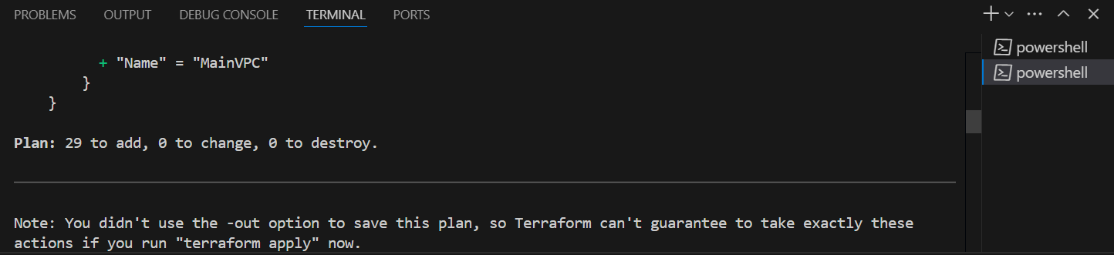
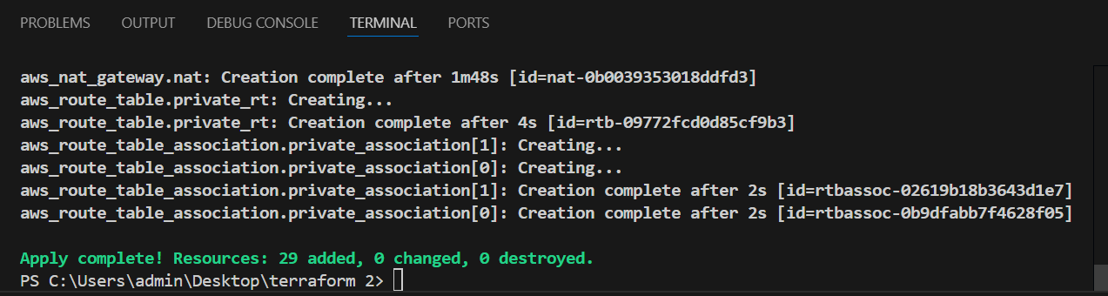
After run terraform plan
After plan changes has been applied its shown below:
And next terraform apply
Run apply changes has been applied its shown below:

Slide 32
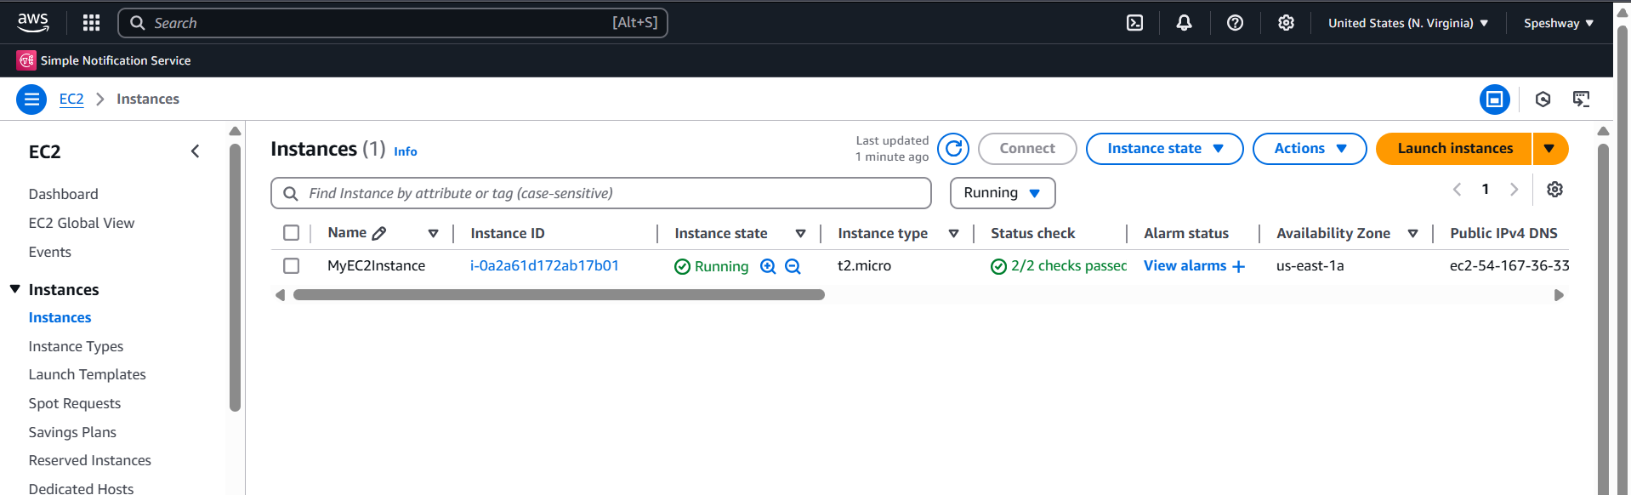
After run finally ec2 instance has been created its shown below:

Slide 33
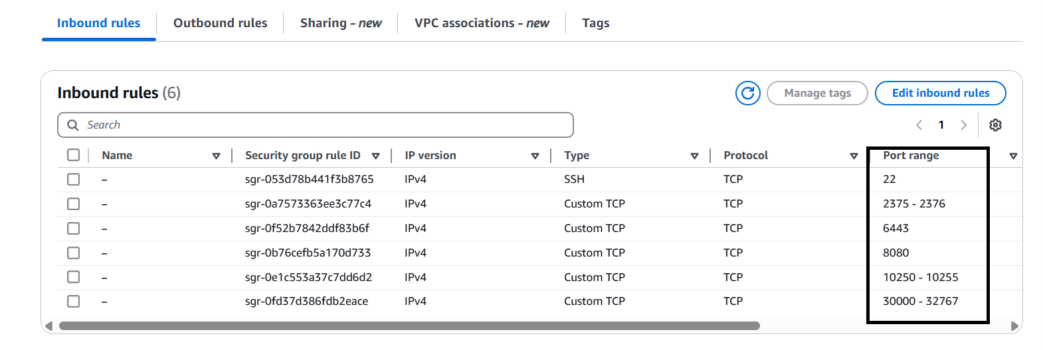
Security groups has been created its shown below :

Slide 34
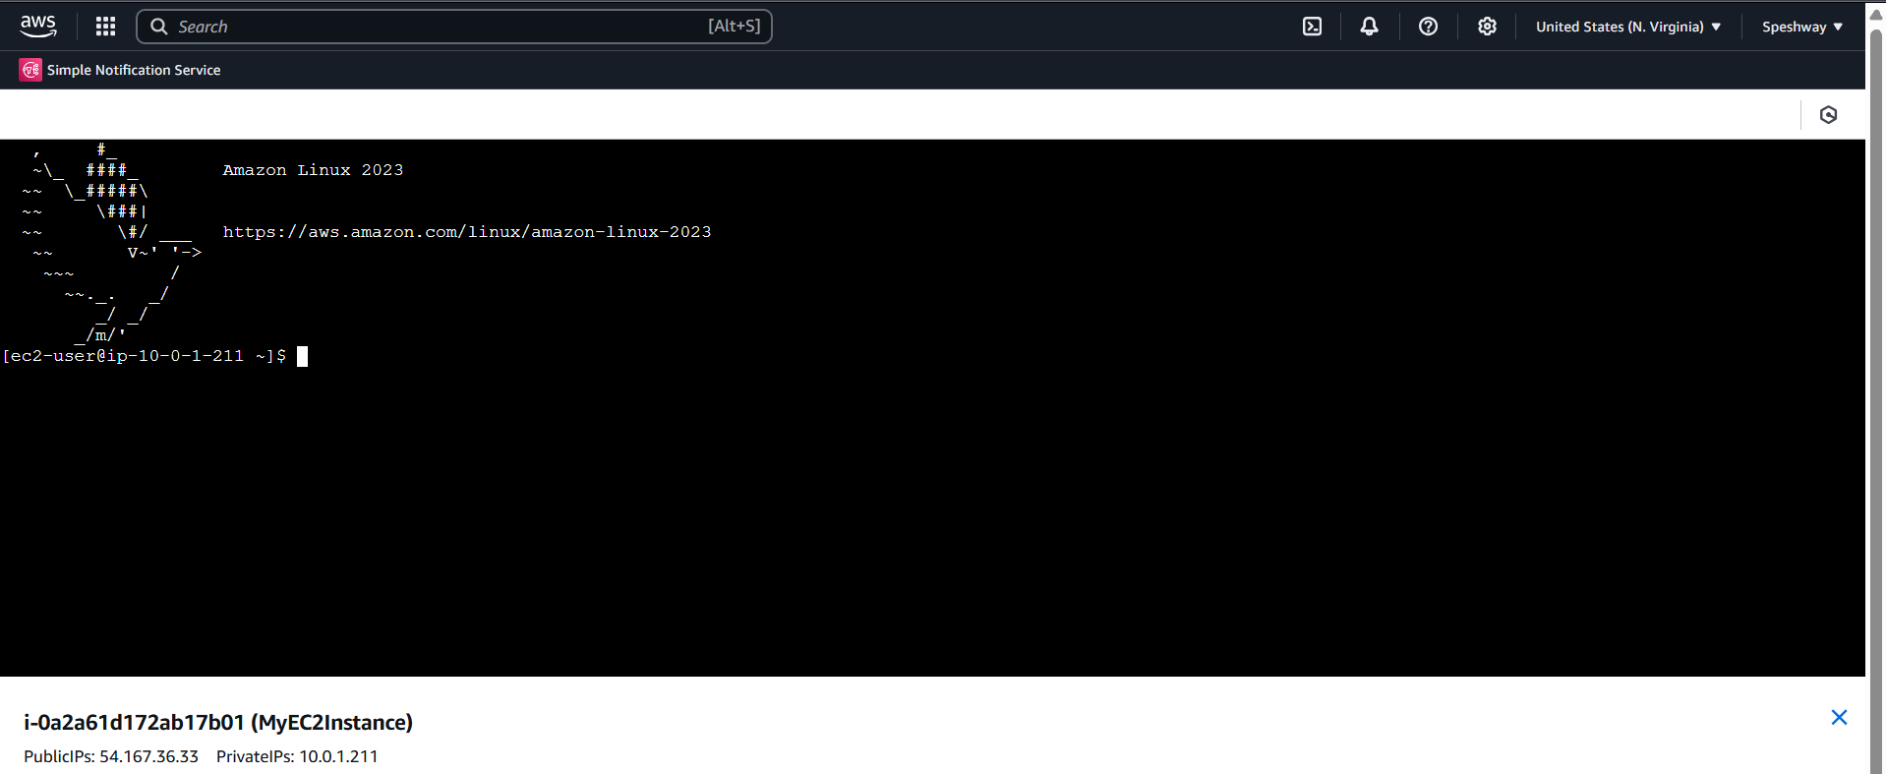
Connect to ec2 instance with (git bash.mobaXterm…….)its shown below.

Slide 35
Create IAM Group for EC2 Full Access
resource "aws_iam_group" "groups" {
count = 5
name = "EC2FullAccessGroup-${count.index + 1}"
}
resource "aws_iam_policy_attachment" "ec2_full_access" {
count = 5
name = "EC2FullAccessAttachment-${count.index + 1}"
groups = [aws_iam_group.groups[count.index].name]
policy_arn = "arn:aws:iam::aws:policy/AmazonEC2FullAccess"
}
Creates 5 IAM groups with full EC2 access.

Slide 36
After run terraform plan
After plan changes has been applied its shown below:
And next terraform apply
Run apply changes has been applied its shown below:

Slide 37
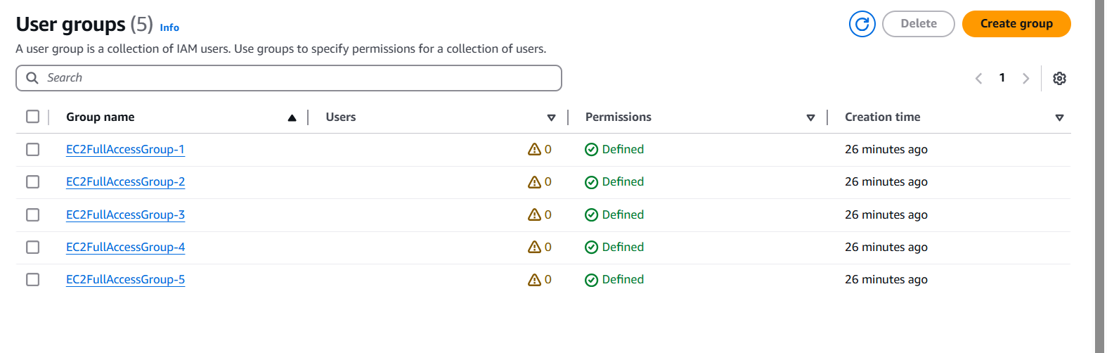
After run finally IAM User Groups has been created its shown below:

Slide 38
Summary
This Terraform project automates AWS infrastructure deployment, ensuring a secure, scalable, and production-ready setup. It efficiently provisions networking, compute, security, and IAM configurations, making it ideal for Kubernetes, Docker, and CI/CD applications.
Fully automated, scalable, and ready for cloud-native workloads!

Slide 39
Thank you

